Slide 1
1.1 History of C Language
Language Name | Year of development | Description
ALGOL 60 | 1960 | TOO ABSTRACT AND TOO SHORT
CPL | 1963 | COMBINED P.L
BCPL | 1967 | USED TO WRITE SYSTEM S/W. WAS NOT SO POWERFUL.
B | 1970 | MACHINE DEPENDENT
C | 1972 | GENERAL PURPOSE,COMPILED, STRUCTURED P.L, WITH UNIX O.S
- ‘C’ LANGUAGE WAS DEVELOPED BY ‘DENNIS RITCHIE’ AT AT &T BELL LABORATORY IN 1972.

Slide 2
Importance of C
It is robust language whose rich set of built in functions and operators can be used to write any complex program.
The language is very well suited from writing both system s/w and business package. We can also write compilers .
We can also write structural programs using C language.
Character Set of C
LETTERS | A-Z, a-z
DIGITS | 0-9
SPECIAL CHARACTER | _ ,! , etc.
WHITE SPACES | tab , enter , etc.
The white spaces are ignored by compiler unless they are part of strings.

Slide 3
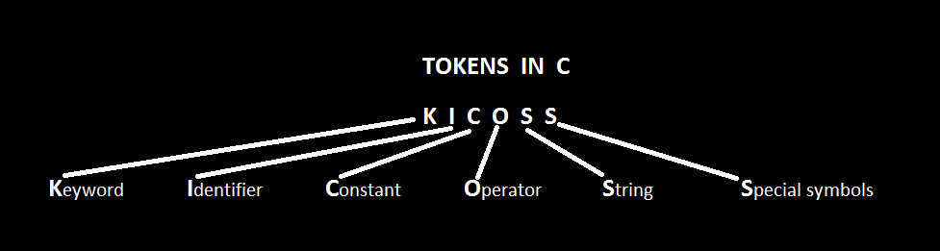
1.2 TOKENS IN C
To form a program i.e. set of executable statement , we need grammar. Like all language , C language also has its own rules and grammar known as syntactic rules / syntax.
The smallest individual unit in a program is known as ‘Token’.
e.g. int, char, float, do , etc | Num , hello, world, etc | e.g. 10,5, 90.11, etc | e.g. + , - , * , %,/, etc | e.g. “Hello This is 1st lecture” | e.g. {},[], etc

Slide 4
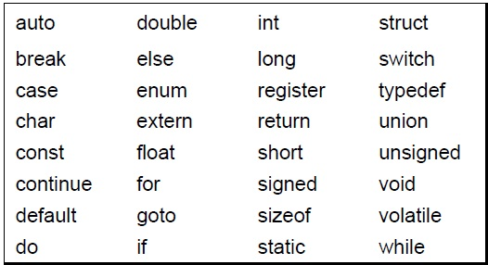
i) Keywords
A keyword is a reserved word whose meaning can’t be changed by user.
Keyword serves as a basic building block for program design and development. The keywords must be written in ‘Lower Case’ , they have predefined meaning .
The C language consists of 32 keywords. Table 1.1 Keywords in ANSI C

Slide 5
ii)Identifier
The words other than the keywords that are used in C program are known as ‘Identifiers’. These are the names that can be given to various program elements as variable, function, etc.
Identifier is user defined name.
The language identifies only 1st 32 characters as the identifiers.
Naming rules for identifier
First letter of identifier should not start with a digit
Upper case and lower case letters are different
The keyword name can’t be identifier
White spaces and special symbols except underscore( _ ) are not allowed

Slide 6
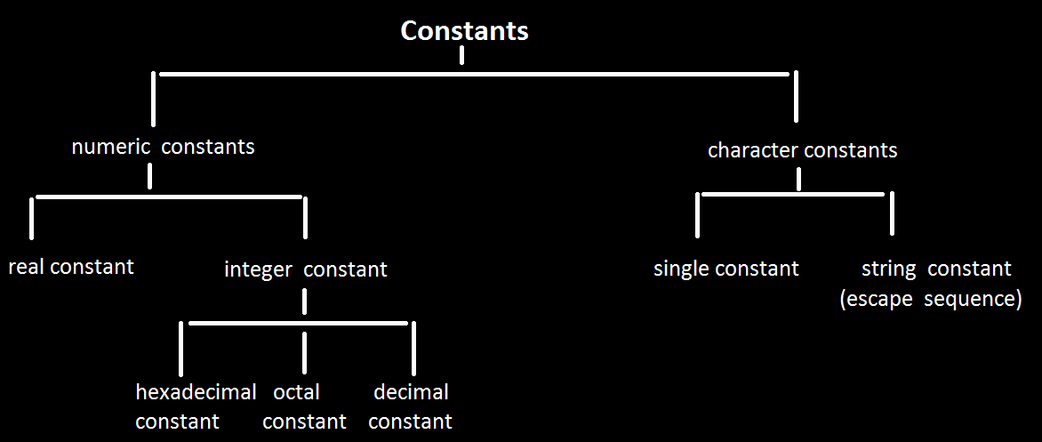
iii) Constants
In C language , the constants are referred to fixed values that don’t change during program execution.
Figure 1.1: Types of constants in C

Slide 7
a)Integer Constants
Decimal Integers : consists of a set of digits 0 to 9 preceded by an optional + or – sign. Spaces, commas and non digit characters are not permitted between digits.
e.g. 12, -44 , 787878
Octal Integers : consists of any combination of digits from 0 to 7 with prefix O.
e.g. O26, O22 , O7
Hexadecimal Integers : it is preceded by OX or Ox, they may contain alphabets from A to F(10-15) or a to f(10-15)
The quantities that are represented by numbers containing fractional parts are called real or floating point constants. These quantities are represented by numbers containing fractional parts like 98.72.
e.g. 0.0023, -9.8
b)Real Constants

Slide 8
c) single character constants
These constants are of a single character may be an alphabet, digit or special symbol that is enclosed in a pairs of single quotation marks .
e.g. ‘x’ , ‘12’ , ‘ . ’ , etc.
These consists of the sequence of characters that are enclosed within a pairs of a double quotation marks.
e.g. “Introduction of C” , “XYZ 123 ” , etc.
In C , every string is terminated by ‘\0’ . It is null character that is automatically added to the string by the compiler . It is backslash character constant. These are also known as escape sequence character .
d) string character constants

Slide 9
Escape sequence characters
Backslash used in front of these characters tells the compiler to escape from regular behavior and perform the desired function.
List of the other such characters is as shown
\n new line
\b backspace
\t horizontal space
\o null character
\r carriage return
The constants can be defined in 2 ways in program.
-we can give a direct value that is used as constant. E.g. int a=10.
-we can use #define preprocessor directive. E.g. #define PI 3.14

Slide 10
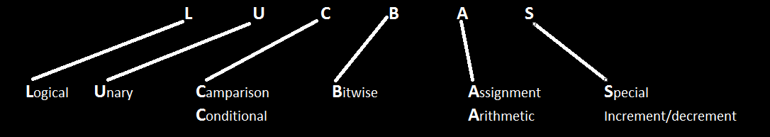
iv)Operator
A operator is defined as a symbol that tells the computer to perform certain mathematical or logical manipulation.
These are basically used to manipulate data .
C provides a rich set of built in operators.

Slide 11
a) Arithmetic Operator
The C language supports various different arithmetic operators as +,-,/,*,%. The % is known as modulus operator used to find remainder of an expression.
Integer Arithmetic
An arithmetic operation performed on 2 whole numbers/ integers . It always gives an integer result. In integer division the fractional part is truncated.
Floating point Arithmetic
An arithmetic operation performed on 2 real / fractional numbers. It results can be truncated according to the properties requirement. The remainder operator (%) is not applicable for floating point arithmetic operands.
Mixed mode Arithmetic
An arithmetic operation performed on 1 of real operands and another integer operand. Its result is always real.

Slide 12
b)Comparison Operator
These operators are also known as relational operator. These are used to compare 2 quantities. The value of relational expression is either 0/1. If expression is true then 1 and 0 if its false
Syntax : exp1 relational operator exp2. e.g. -90 > 0 false(0), 11> 7+2 true(1)
Relational operator are used in decision making statements in C language.
symbols | meaning
< | Less than
<= | Less than equal to
> | Greater than
>= | Greater than equal to
== | Equal to
!= | Not equal to

Slide 13
c) Logical Operator
The language supports 3 kinds of logical operator. These are basically used when we want to use more than 1 condition and make certain decision.
i)Logical AND (&&) ii)Logical OR(||)
iii) Logical NOT(!)
A | B | o/p : A && B
0 | 0 | 0
0 | 1 | 0
1 | 0 | 0
1 | 1 | 1
A | B | o/p : A|| B
0 | 0 | 0
0 | 1 | 1
1 | 0 | 1
1 | 1 | 1
A | o/p: !A
0 | 1
1 | 0

Slide 14
v) Assignment Operator
These are used to assign the result of an expression to a variable / it can also be used to assign value to a variable.
In case of assignment operator L.H.S must be a variable but R.H.S can be expression or any constant value.
e.g. A = 2, x = A + 3
C language also supports set of short hand assignment operator .
Operator | Stmt with simple assign operator | Stmt with shorthand property
+= | a=a+1 | a+=1
-= | a=a-1 | a-=1
*= | a=a*1 | a*=1
/= | a=a/1 | a/=1
%= | a=a%1 | a%=1

Slide 15
vi)Conditional Operator
Conditional operator operates 3 conditions, hence also known as ternary operator.
Syntax : expr1 ? expr2 : expr3;
e.g. (5>10)? printf(“5”); : printf(“10”);
Expr1 is evaluated first. Its value is either true or false . If it is true the expr2 is evaluated and this becomes value of complete expr. If expr1 is false, then expr3 is evaluated and this becomes the value of complete expr. Only 1 of the expr’s i.e expr2/ expr3 will be evaluated but not both.
Conditional operator is short form of if…else structure.

Slide 16
vii)Bitwise Operator
C language also supports various bitwise operator that operates at bit level. These are used to test bits them in left / right.
The o/p of bitwise AND is 1 if all the corresponding bits of all operands is 1.
The o/p of bitwise OR is 1 if at least one corresponding bits of all operands is 1.
The o/p of bitwise XOR is 1 if the corresponding bits of 2 operands are opposite.
Bitwise complement operator is an unary operator. It changes 1 to 0(condition).
operator | meaning
& | Bitwise and
| | Bitwise or
~ | Complement
^ | Bitwise exclusive or
<< | Shift left
>> | Shift right

Slide 17
viii) Special Operator
C language also supports some special operators as comma, sizeof(), pointer operator (*), member selection operator( . )
i) comma operator :
It is used to separate variables.
e.g. int a,b,c;
ii) sizeof operator :
The sizeof is a compile time operator that returns the numbers of bytes the operand occupies. The operand may be a variable , constant or datatype qualifier.
e.g. int x,y;
y=sizeof(x);
o/p: y = 2

Slide 18
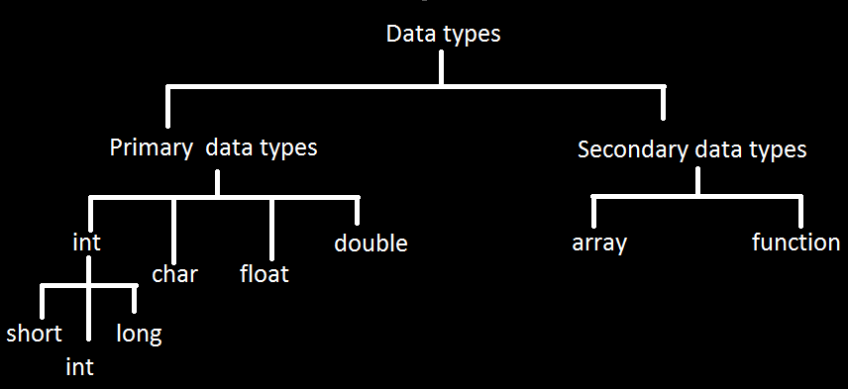
1.3 Data Types in C
Datatype means type of data which we are going to give to computer for processing. It basically used to calculate the memory requirement.
fig. 1.2. Data types in C

Slide 19
Primary Data Types
These are the built in and fundamental data types .
Integers are whole numbers i.e. numbers without decimal point. All these data types short int, int, long int have signed & unsigned forms. Unsigned numbers are always positive.
Floating point numbers are real numbers. It has 6 digits of precision. These numbers are denoted by keyword float. When accuracy of floating point number
is insufficient , we use double keyword, it has 14 digits precision. To extend precision further , we use long double.
It is used to specify type of function. When function does not return any value and if there is empty parameter list
It is declared using keyword char. It stores single character item.
Integer Type
Floating Point Type
Void Type
Character Type

Slide 20
Storage space requirement
Type | Size | Range
short int | 8 bits(1 byte) | -128 to 127
int or signed int | 16 bits(2 bytes) | -32768 to 32767
Unsigned int | 16 bits(2 bytes) | 0 to 65535
Long int | 32 bits(4 bytes) | -2,147,483,648 to 2,147,483,648
Unsigned long int | 32 bits(4 bytes) | 0 to 4,294,967,295
Float | 32 bits(4 bytes) | 2^32
Double | 64 bits(8 bytes) | 2^64
Long double | 80 bits(10 bytes) | 2^80
Char | 8 bits(1 byte) | -128 to 127
Table 1.2 Primary data types in C

Slide 21
1.4 Variables in C
A variable is used to store data. It tells compiler variable name and data type of variable.
Declaration : datatype identifier;
e.g. int x,y,z;
Converting lower type to higher type and vice versa, is known as type conversion.
Lower type is automatically converted into higher type
It is the process of local conversion. Its also known as type casting
Syntax : (type name) expression;
Type name is standard data type in c
Type Conversion
a) Implicit Conversion
b)Explicit Conversion

Slide 22
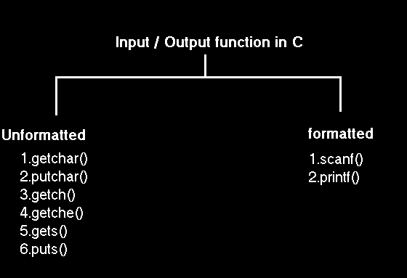
1.5 Input and Output in C
fig.1.3 input/output function in C

Slide 23
Format specifiers
symbol | use
%d | integer
%f | Float value
%c | Character value
%s | String value
%u | Unsigned integer value
%ld | Long int

Slide 24
1.6 Structure of C Program
Documentation Section
Link Section
Definition Section
Global Declaration Section
Main()
{ Declaration Part; Executable Part; }
Subprogram Section : Function 1, Function 2, Function 3

